Slide 1
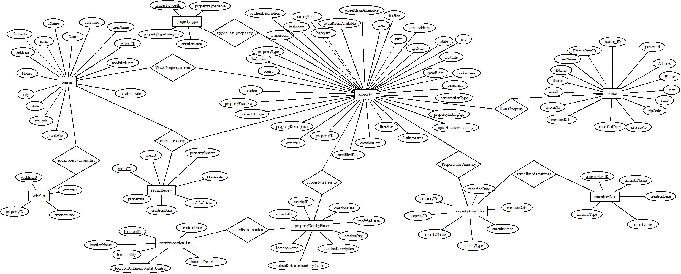
Conceptual ER Diagram StayMatch Web Application

Slide 2
Logical ERD Diagram StayMatch Web Application

